Slide 1
Canvas
Advanced Android Development
Lesson 11

Slide 2

11.1 The Canvas class

Slide 3
Contents
Drawing in Android
What is a Canvas object
Simple drawing in response to user action
Using a Canvas in a custom view
Canvas operations
Clipping
Saving and restoring Canvas state
Summary

Slide 4
Drawing in Android

Slide 5
Drawing 2D custom graphics & animations
Drawables (earlier lesson)
Canvas (this lesson)
SurfaceView (later lesson)
Animations (later lesson)
Not covered:
Hardware acceleration
OpenGL

Slide 6
What is a Canvas object?

Slide 7

Why use a canvas?
Write to a canvas to accomplish more complex drawing than is possible with predefined Views

Slide 8
Canvas class
Canvas class—logical drawing surface for 2D drawing
Use Canvas when app needs to redraw regularly
Clipping defines user-visible portions
onDraw() method runs on UI Thread
Use Profile GPU Rendering tool to monitor performance of your drawing operations

Slide 9
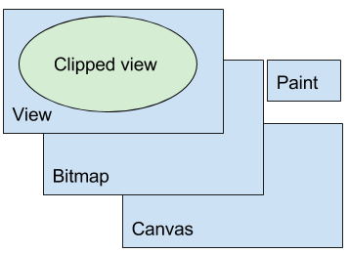
Classes required to draw
You need a View, a Bitmap, a Canvas, and a Paint object
View displays Bitmap
Bitmap is physical drawing surface
Canvas API to draw on/clip bitmap
Paint styles what you draw

Slide 10
Overview of steps to draw
Create Bitmap
Associate Bitmap with View
Create Canvas with Bitmap object and style using Paint object
Draw in onDraw()
Call invalidate() on the View ...asks Android to redraw display

Slide 11
Simple drawing in response to user action

Slide 12
Use a canvas in an ImageView
You can use an ImageView to draw to a canvas
Define the ImageView's onClick handler to draw to the canvas
The next few slides step through using an ImageView to draw to a Canvas

Slide 13
Create ImageView in XML
<ImageView
android:id="@+id/myimageview"
android:layout_width="match_parent"
android:layout_height="match_parent"
android:onClick="drawSomething"/>
drawSomething() will draw to the canvas

Slide 14
Bitmap
In the Activity class, create Bitmap member variable
Bitmap represents the pixels shown on the display
Bitmap will be created inside onClick handler
private Bitmap mBitmap;

Slide 15
ImageView
Create ImageView member variable
View is the container for the Bitmap
Layout on screen and user interaction is through View
ImageView mImageView;
mImageView = (ImageView)
findViewById(R.id.myimageview);

Slide 16
Canvas
Create Canvas member variable
Canvas object stores information about what to draw onto its associated Bitmap: lines, circles, text, paths
Canvas will be created inside onClick handler
private Canvas mCanvas;

Slide 17
Paint
Create Paint object
Stores how to draw: color, style, line thickness, text size
Paint object can persist outside onClick handler– no need to recreate it every time onClick triggers
private Paint mPaint = new Paint();

Slide 18
Paint code example
private Paint mPaint = new Paint();
private Paint mPaintText = new Paint(Paint.UNDERLINE_TEXT_FLAG);
mPaint.setColor(mColorBackground);
mPaintText.setColor(
ResourcesCompat.getColor(getResources(),
R.color.colorPrimaryDark, null)
);
mPaintText.setTextSize(70);

Slide 19
onClick handler
Define onClick handler to draw to the canvas:
Create Bitmap
Associate Bitmap with ImageView
Create Canvas with Bitmap
Draw on Canvas
Call invalidate() on the View to force redraw

Slide 20

Example onClick code
mBitmap = Bitmap.createBitmap(
vWidth, vHeight, Bitmap.Config.ARGB_8888);
mImageView.setImageBitmap(mBitmap);
mCanvas = new Canvas(mBitmap);
mCanvas.drawColor(mColorBackground);
mCanvas.drawText(getString(R.string.my_string),
100, 100, mPaintText);
view.invalidate();

Slide 21
Using a Canvas object in a custom view

Slide 22
Common pattern
A more common pattern for using the Canvas class:
Subclass one of the View classes
Override onDraw() and onSizeChanged() to draw
Override onTouchEvent() to handle user touches

Slide 23
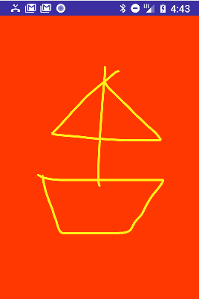
Example usage scenario
For example, user draws a picture on the canvas

Slide 24
Create custom View class
Create a custom View class
Extend any View that has features you need
public class MyCanvasView extends View {...}

Slide 25
Use setContentView()
Set content View of activity to instance of custom View:
MyCanvasView myCanvasView;
myCanvasView = new MyCanvasView(this);
setContentView(myCanvasView);

Slide 26
Initialize Paint object
In constructor of the custom View:
Create Paint object and set initial properties
Initialize member variables
Get a reference to the context
Cannot create Canvas yet because uninflated View has no size

Slide 27
Paint code example
mPaint = new Paint();
mPaint.setColor(backgroundColor);
mPaint.setAntiAlias(true);
mPaint.setDither(true);
mPaint.setStyle(Paint.Style.STROKE); // default: FILL
mPaint.setStrokeJoin(Paint.Join.ROUND); // default: MITER
mPaint.setStrokeCap(Paint.Cap.ROUND); // default: BUTT
mPaint.setStrokeWidth(12); // default: Hairline-width

Slide 28
Create Bitmap in onSizeChanged()
In custom View, override onSizeChanged()
Create Bitmap
Create a Canvas with the Bitmap
onSizeChanged()
Called when View is first assigned size, and when View size changes
In onSizeChanged() calculate positions, dimensions, anything related to View size

Slide 29
onSizeChanged() code example
@Override
protected void onSizeChanged(int width, int height,
int oldWidth, int oldHeight) {
super.onSizeChanged(width, height, oldWidth, oldHeight);
mBitmap = Bitmap.createBitmap(width, height,
Bitmap.Config.ARGB_8888);
mCanvas = new Canvas(mBitmap);
mCanvas.drawColor(mDrawColor);
}

Slide 30
Override onDraw() code
Can be simple or complex, must be fast, runs on UI Thread
@Override
protected void onDraw(Canvas canvas) {
super.onDraw(canvas);
canvas.drawBitmap(mBitmap, 0, 0, mPaint);
canvas.drawPath(mPath, mPaint);
}

Slide 31
Override onTouchEvent()
Drawing in response to user motion
In example below, invalidate() is inside the case statements because there are many other types of motion events passed into this listener, and we don't want to invalidate the view for those

Slide 32
Override onTouchEvent() code example
switch (event.getAction()) {
case MotionEvent.ACTION_DOWN:
touchStart(x, y);
break;
case MotionEvent.ACTION_MOVE:
touchMove(x, y);
invalidate();
break;
case MotionEvent.ACTION_UP:
touchUp();
invalidate();
break;

Slide 33
Example code
private void touchMove(float x, float y) {
float dx = Math.abs(x - mX); // distance moved
float dy = Math.abs(y - mY);
if (dx >= TOUCH_TOLERANCE || dy >= TOUCH_TOLERANCE) {
// QuadTo() adds a quadratic bezier from the last point,
// approaching control point (x1,y1), and ending at (x2,y2).
mPath.quadTo(mX, mY, (x + mX)/2, (y + mY)/2);
mX = x;
mY = y;
}
}

Slide 34
Canvas operations

Slide 35
Canvas summary
You need a View, a Canvas, a Paint , and a Bitmap object
The Bitmap is the physical drawing surface. The Canvas provides an API to draw on the Bitmap, the Paint is for styling what you draw, and the View displays the Bitmap
You create a Bitmap, associate it with a View, create a Canvas with a Paint object for the Bitmap, and then you can draw
You must invalidate() the View when your are done drawing, so that the Android System redraws the display
All drawing happens on the UI thread, so performance matters

Slide 36
Operations (1)
Fill Canvas with color
Draw shapes, such as rectangles, arcs, paths
Draw text styled by the properties in a Paint object
Style shapes and text using Paint objects

Slide 37
Operations (2)
Save and restore Canvas state
Apply transformations, such as translation, scaling, or custom transformations
Clip—apply a shape or path to define visible portions of Canvas

Slide 38
Filling Canvas with color
mCanvas.drawColor(mColorBackground);

Slide 39
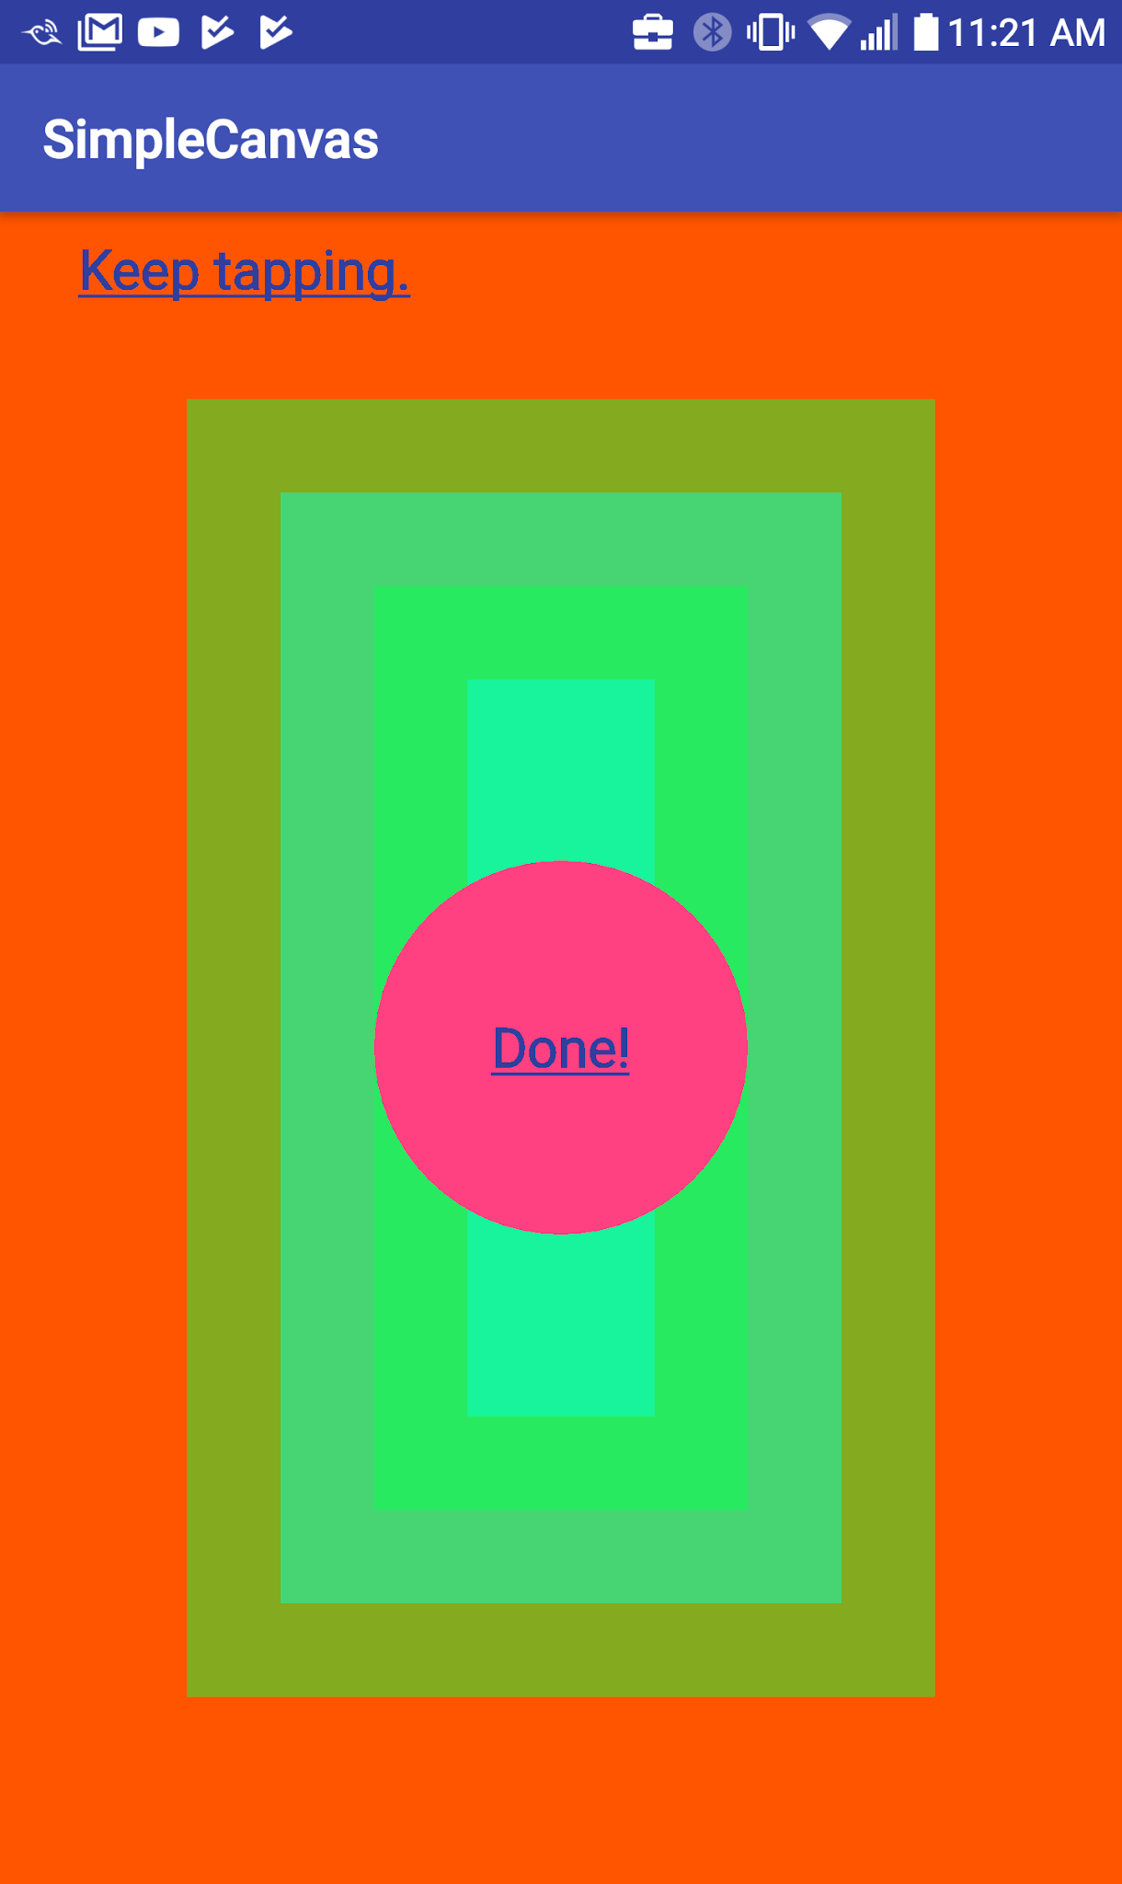
Drawing primitive shapes
Primitive shapes: drawRect(), drawOval(), drawArc()
Filled, outlined, or both: setStyle()
mPaint.setStyle(Paint.Style.FILL_AND_STROKE);
mCanvas.drawCircle (x, y, radius, mPaint);
mRect.set (x, y, width, height);
mCanvas.drawRect(mRect, mPaint);

Slide 40
Drawing complex shapes
Draw more complex shapes using the Path class
Define a shape by adding lines and curves to a Path object, then draw the shape using drawPath()
As with primitive shapes, paths can be outlined, filled, or both, depending on the setStyle()

Slide 41
Drawing text
Draw text using drawText()
Specify typeface using setTypeface()
Set text color using setColor()
mPaintText.setColor(textColor);
mPaintText.setTypeface(Typeface.DEFAULT_BOLD);
mCanvas.drawText(getString(R.string.keep_tapping), 100, 100, mPaintText);

Slide 42
Transformations: translate()
Use translate() to move the origin of the canvas
Use to draw the same shape in different locations
canvas.translate(dx, dy);

Slide 43
Transformations: rotate()
Use rotate() to turn the canvas by a number of degrees
canvas.rotate(180);

Slide 44

Transformations: skew()
Skew the canvas by calling the skew() method
You can achieve interesting text effects using skew()
canvas.skew(0.2f, 0.3f);

Slide 45
Combining transformations
mPaint.setTextSize(120);
canvas.translate(100, 1800);
canvas.skew(0.2f, 0.3f);
canvas.drawText("Transformed", 400, 60, mPaint);

Slide 46
Clipping

Slide 47
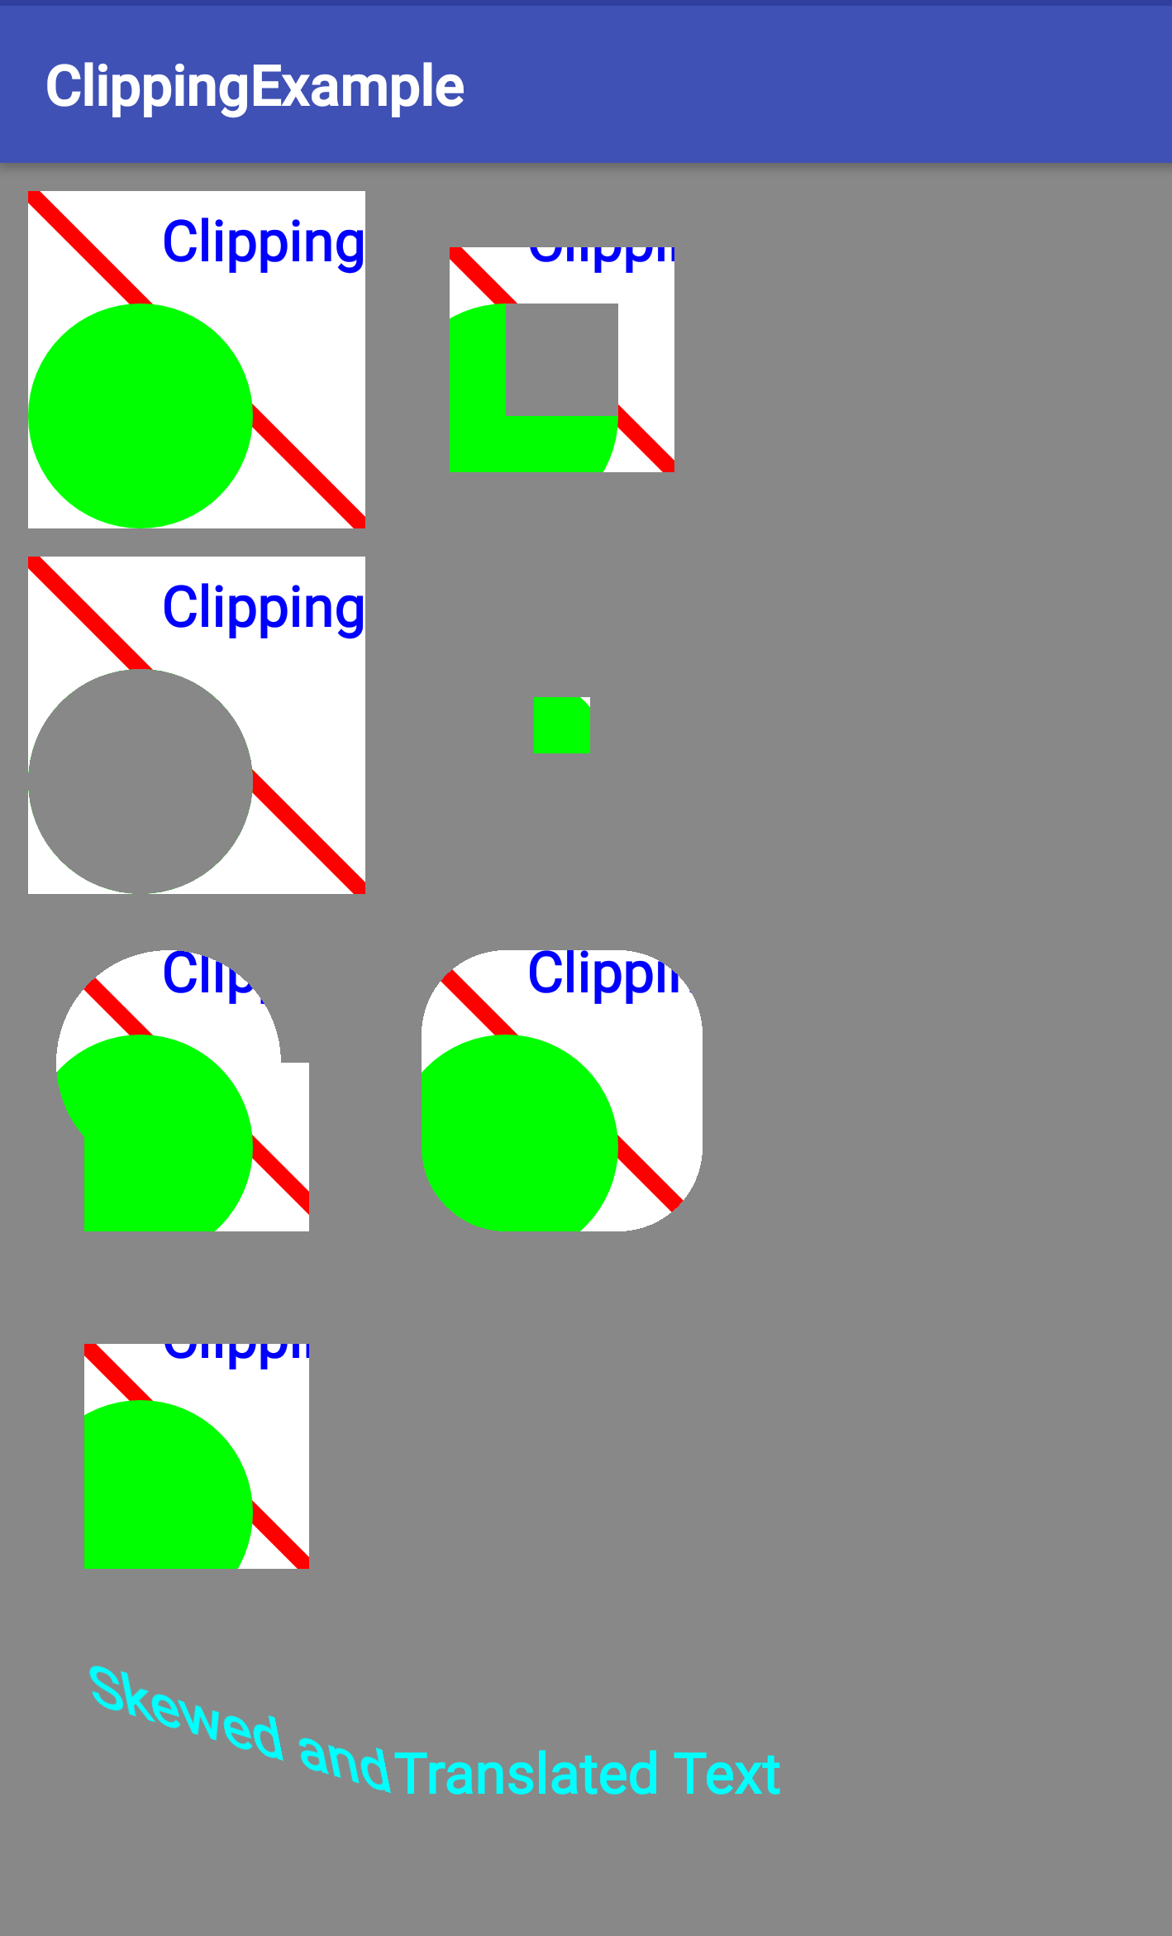
What is clipping?
Clipping is a way to define regions of an image, canvas, or bitmap that are drawn or not drawn onto screen
Reduce overdraw
Improve performance by drawing less
Create interesting UI effects and animation

Slide 48
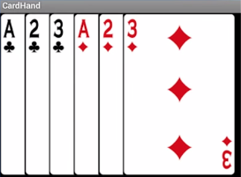

What is clipping good for?
Only draw visible portions of cards
Only show relevant parts of an image
Define clipping region of any shape

Slide 49
clipRect()
Use canvas.clipRect() to set a rectangular clipping region
canvas.clipRect(x, Y, right, bottom);

Slide 50
clipPath()
Use canvas.clipPath() for a custom clipping region:
mPath.addCircle(radius, x, y, Path.Direction.CCW); canvas.clipPath(mPath, Region.Op.DIFFERENCE);
CCW means draw circle counterclockwise
Region.Op.DIFFERENCE indicates how to apply region to canvas

Slide 51
quickReject()
quickReject() checks whether a specified rectangle or path would lie completely outside the currently visible regions, after all transformations have been applied
Decide efficiently which objects you do not have to draw at all

Slide 52
Complex clipping
Combine or intersect multiple clipping regions

Slide 53
Saving and restoring

Slide 54
Stack of drawing states
Activity context maintains stack of drawing states
Each state includes currently applied transformations and clipping regions
You can't remove clipping regions
Undoing a transformation by reversing it is error-prone

Slide 55
Saving and restoring
Save the state of the Canvas using save()
Apply transformations
Draw
Restore previous Canvas state using restore()

Slide 56
Saving and restoring
canvas.save();
mPaint.setTextSize(120);
canvas.translate(100, 1800);
canvas.skew(0.2f, 0.3f);
canvas.drawText("Skewing", 400, 60, mPaint);
canvas.restore();
canvas.save();
mPaint.setColor(Color.CYAN);
canvas.translate(600, 1800);
canvas.drawText("Save/Restore", 400, 60, mPaint);
canvas.restore();

Slide 57
Summary

Slide 58
Clipping summary
The Context of an Activity maintains a state that preserves transformations and clipping regions for the Canvas
Use canvas.save() and canvas.restore() to draw and return to original state of your Canvas
To draw multiple shapes on a Canvas, either calculate their location or move (translate) the origin of your drawing surface; the latter can make it easier to create utility methods for repeated draw sequences
Clipping regions can be any shape, combination of shapes, or path
Add, subtract, and intersect clipping regions to get exactly the region you need
You can apply transformations to text

Slide 59
What's next?
Concept chapter: 11.1 The Canvas class
Practicals:
11.1A Creating a simple Canvas object
11.1B Drawing on a Canvas object
11.1C Applying clipping to a Canvas object

Slide 60
END

